Slide 1


Interactive Blueprint
Product Review & Sprint Update
April 9, 2026 | SOW 1449, Service 2
Carol Wright • Eli Wood • Keith Pattison • Adrian Dickinson

Slide 2
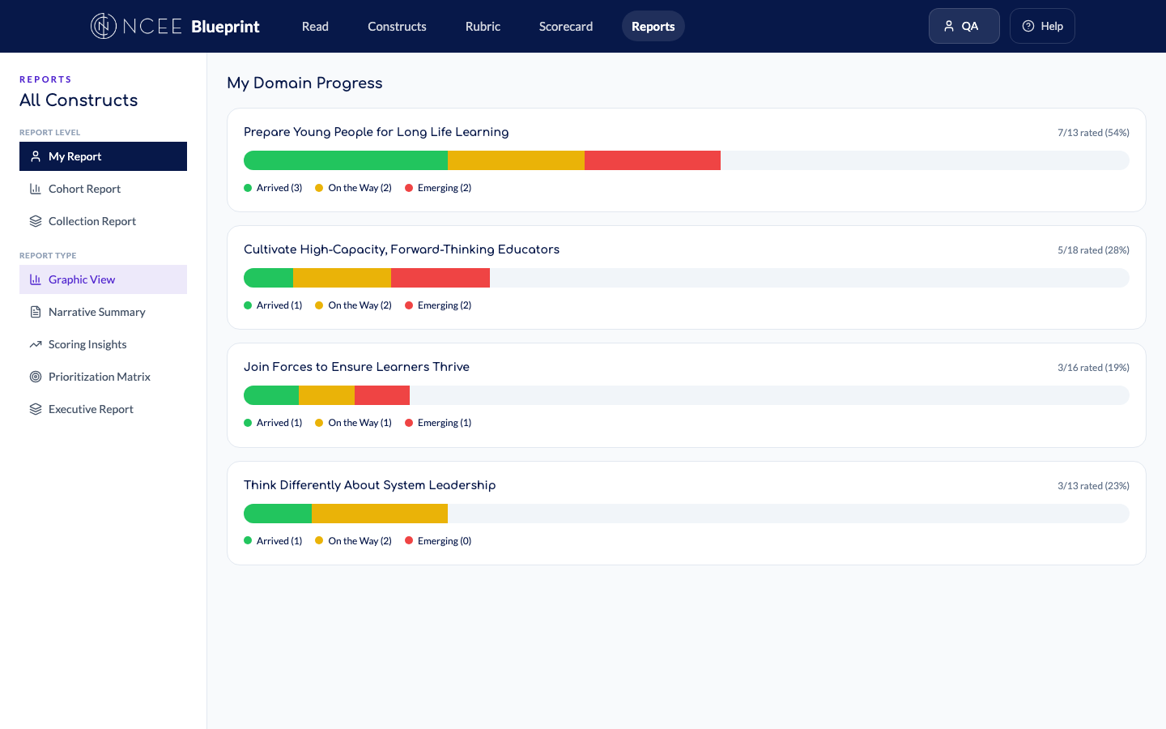
What Is the Interactive Blueprint?
A web application that turns NCEE’s static Blueprint PDF into a structured, data-driven self-assessment platform. Districts evaluate where they stand across 73 constructs organized into four domains — and track progress over time.
Three user types, three tailored experiences:
Participants (district leaders) — read the Blueprint, self-assess, view personal reports
Facilitators (NCEE staff) — manage cohorts, review submissions, access cohort reports
System Admins (R&E team) — manage collections, configure platform, cross-collection reporting
NCEE Interactive Blueprint | Black Flag Design | SOW 1449 | Apr 9, 2026

Slide 3
Platform Architecture
FRONTEND
BACKEND
React + Vite + Tailwind CSS Responsive across desktop, tablet, mobile PDF.js for in-app Blueprint reading
Convex (real-time cloud database) Serverless functions, auto-scaling All data syncs live — no polling
AUTHENTICATION
INTEGRATIONS
Clerk for identity management Salesforce integration maps users to roles Automatic on sign-in — no manual provisioning
Salesforce (user identity + cohort assignment) Cloudflare R2 (static asset storage) OnwardLearn SSO (in progress)
NCEE Interactive Blueprint | Black Flag Design | SOW 1449 | Apr 9, 2026

Slide 4
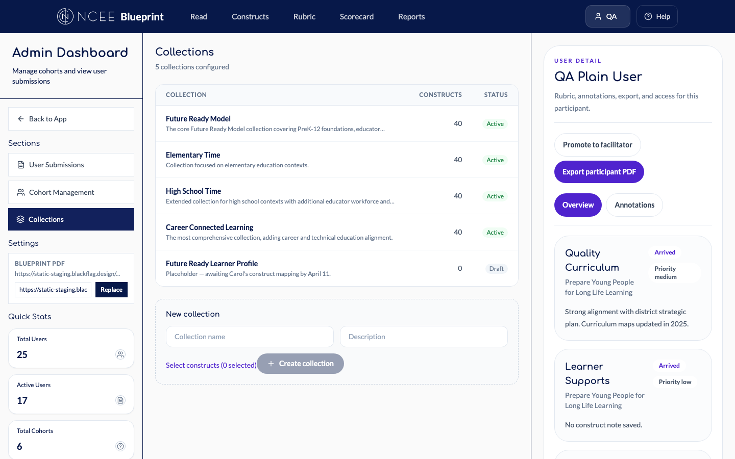
Collections & Scoped Experiences
NEW
The Blueprint’s 73 constructs are organized into named collections — subsets representing different NCEE offerings. When a participant belongs to a cohort assigned to a collection, every page shows only the constructs in that collection. 5 collections configured: Future Ready Model, Elementary Time, High School Time, Career Connected Learning, and Learner Profile (draft).
NCEE Interactive Blueprint | Black Flag Design | SOW 1449 | Apr 9, 2026

Slide 5
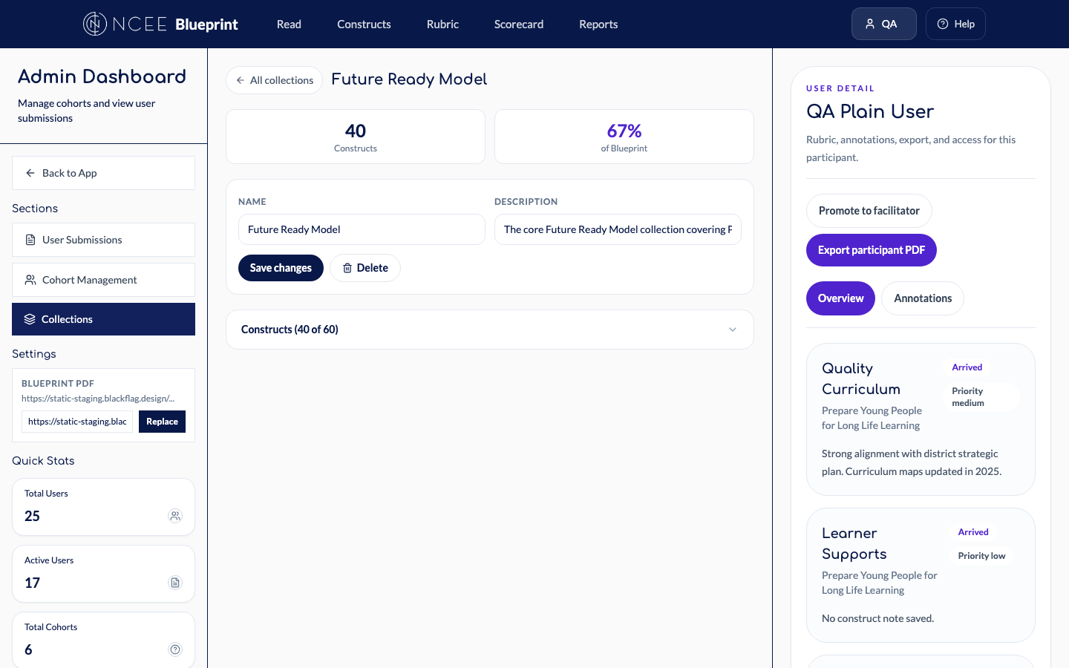
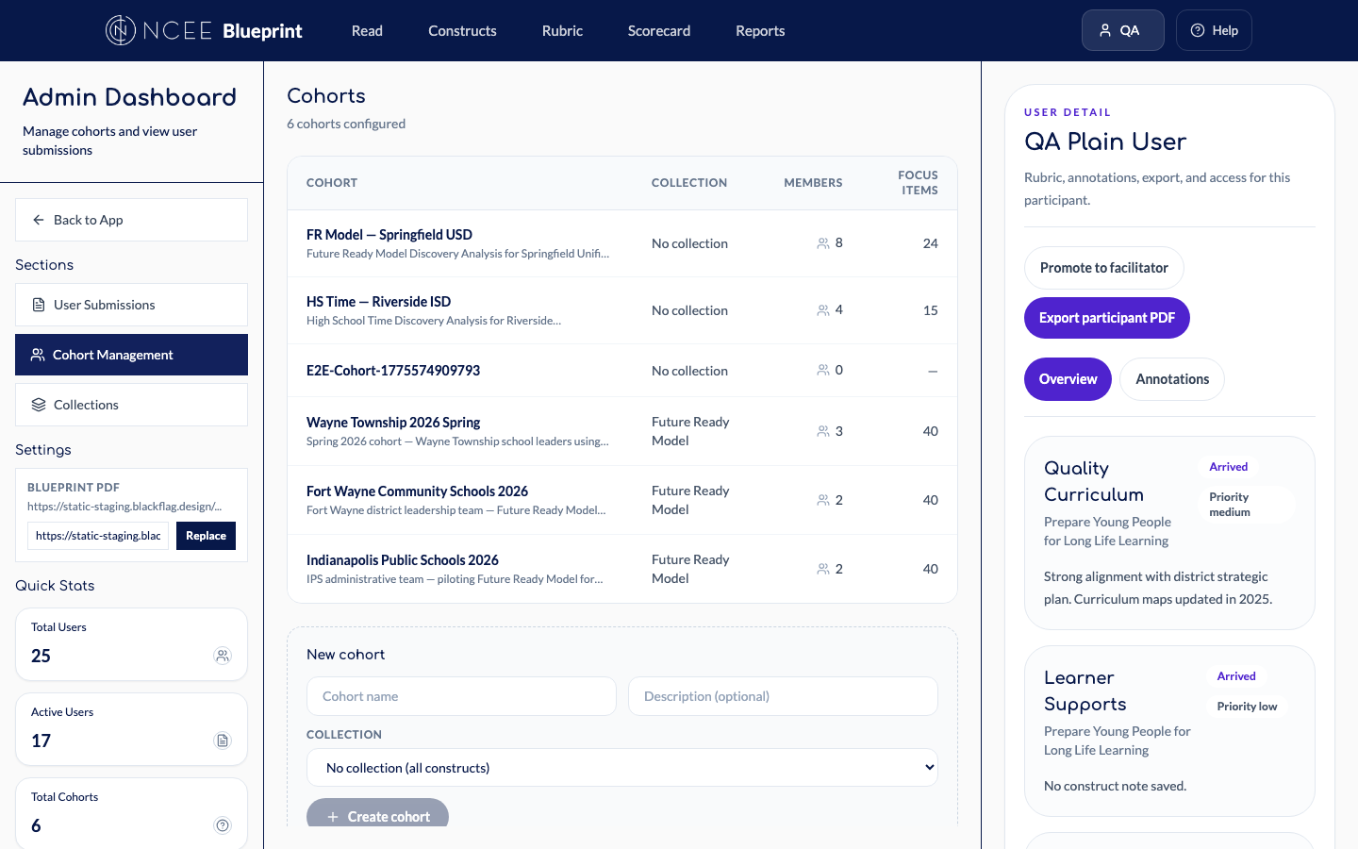
Collection Management & Simplified Cohorts
NEW
Future Ready Model: 40 constructs, 67% of Blueprint. Admins select which constructs belong to each collection.
Creating a cohort is now 3 fields: name, description, collection dropdown. No more scrolling through 73 constructs.
NCEE Interactive Blueprint | Black Flag Design | SOW 1449 | Apr 9, 2026

Slide 6

Reports — Three Levels, Five Types
NEW
Report Levels (who is the audience):
My Report — personal data, coaching tool
Cohort Report — aggregated across cohort members (facilitators + admins)
Collection Report — aggregated across all cohorts (admins only)
Report Types (what kind of analysis):
Graphic View — domain progress heatmap
Narrative Summary — strengths & growth areas
Scoring Insights — constructs by rating level
Prioritization Matrix — rating × interest
Executive Report — completion %, summary stats
NCEE Interactive Blueprint | Black Flag Design | SOW 1449 | Apr 9, 2026

Slide 7
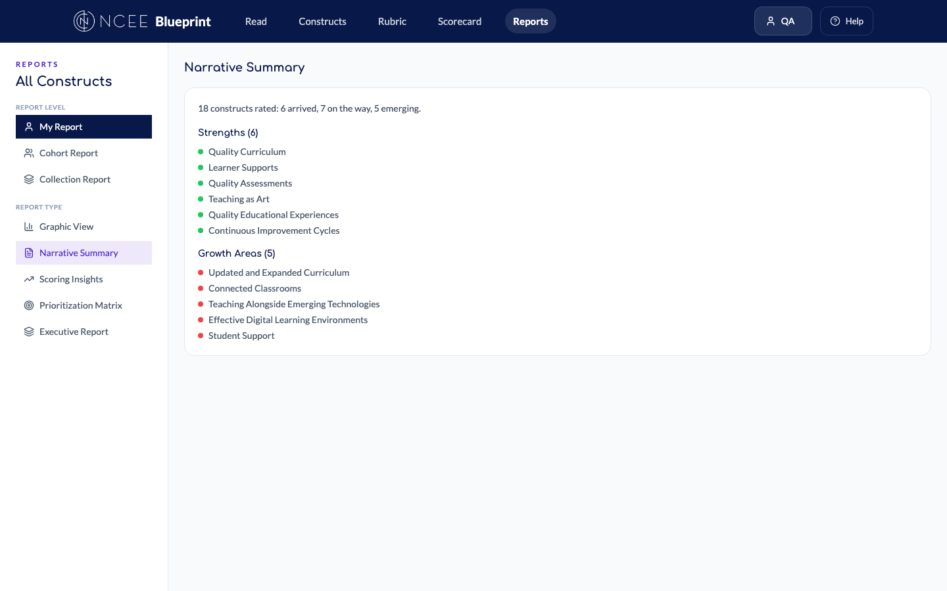
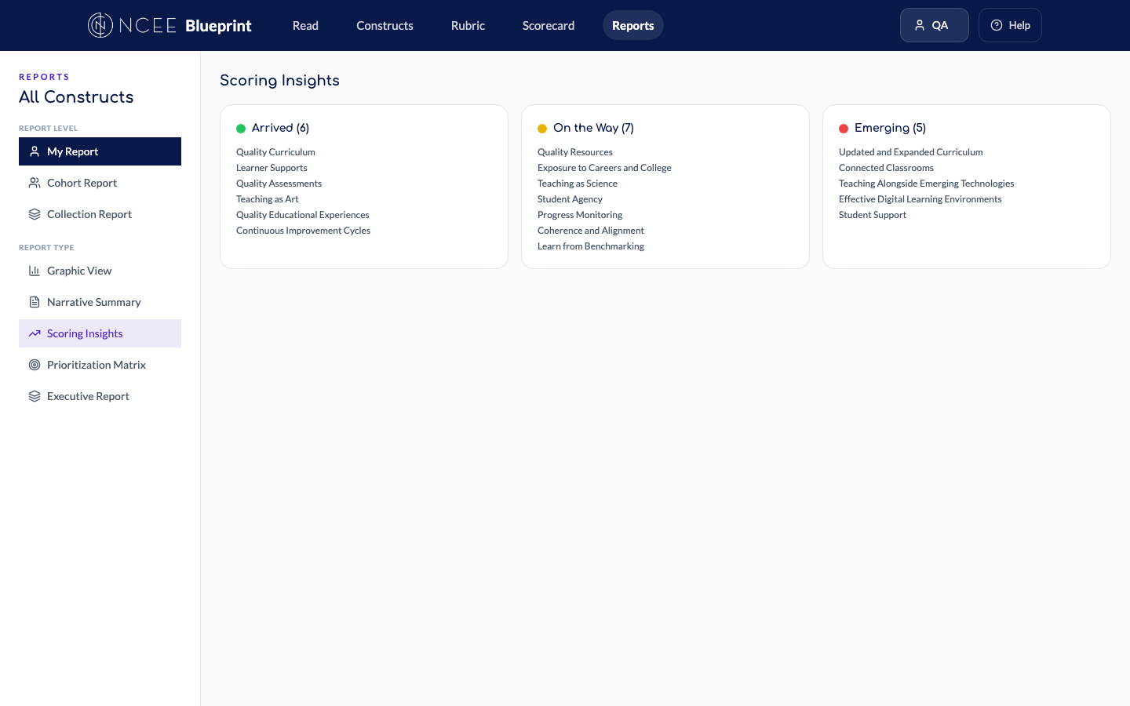
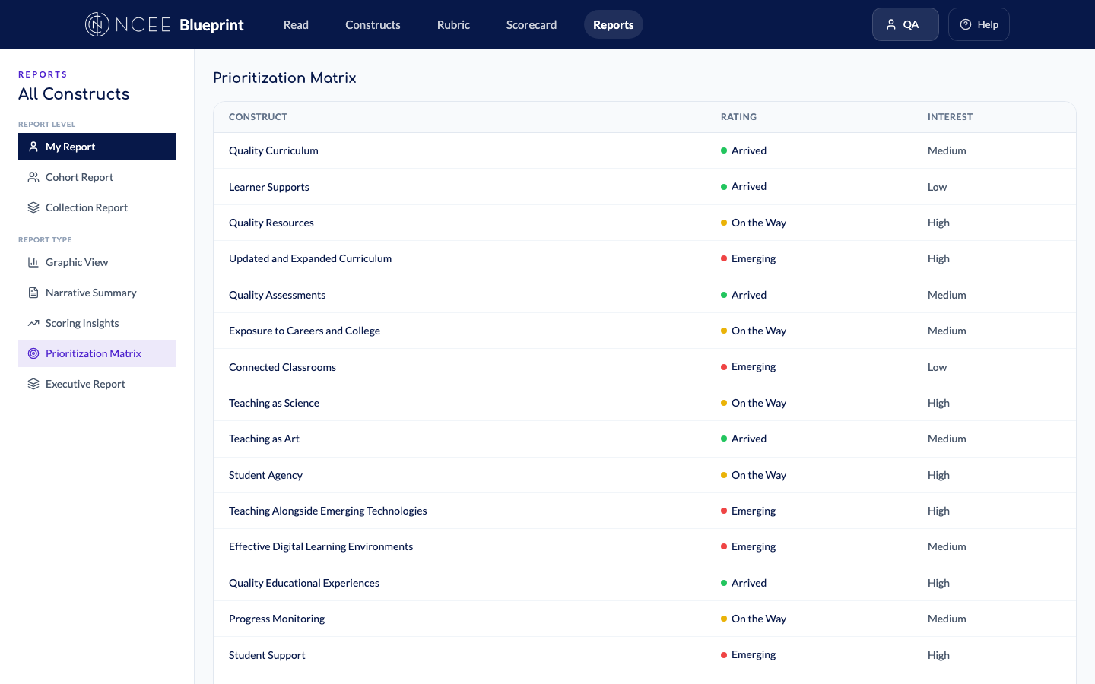
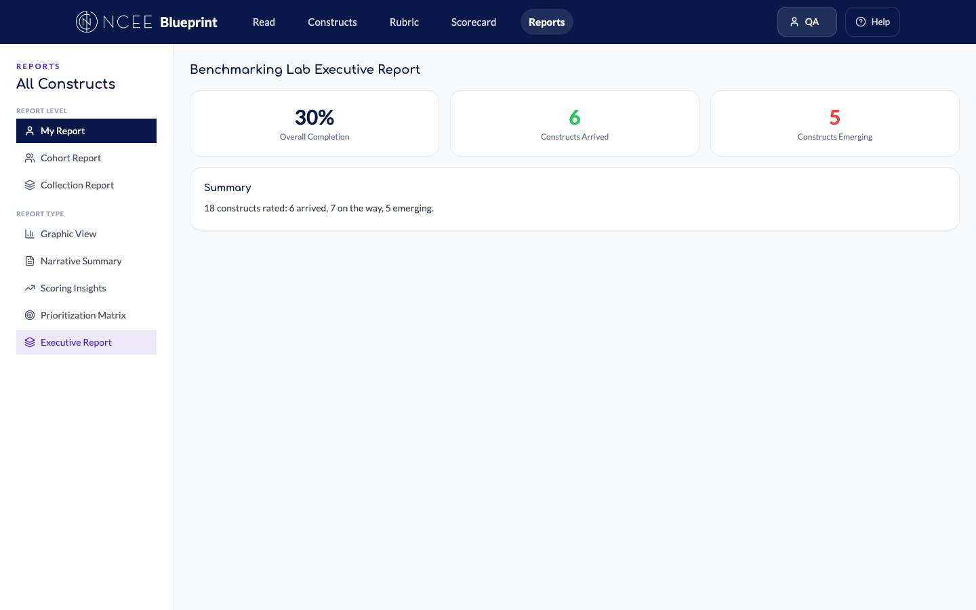
All Five Report Types
Narrative Summary
Scoring Insights
Prioritization Matrix
Executive Report
NCEE Interactive Blueprint | Black Flag Design | SOW 1449 | Apr 9, 2026

Slide 8
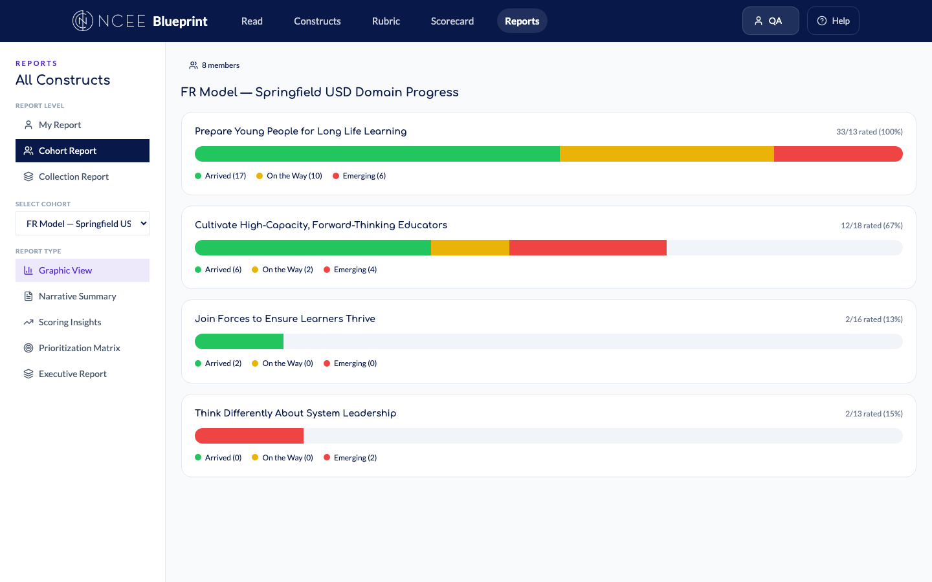
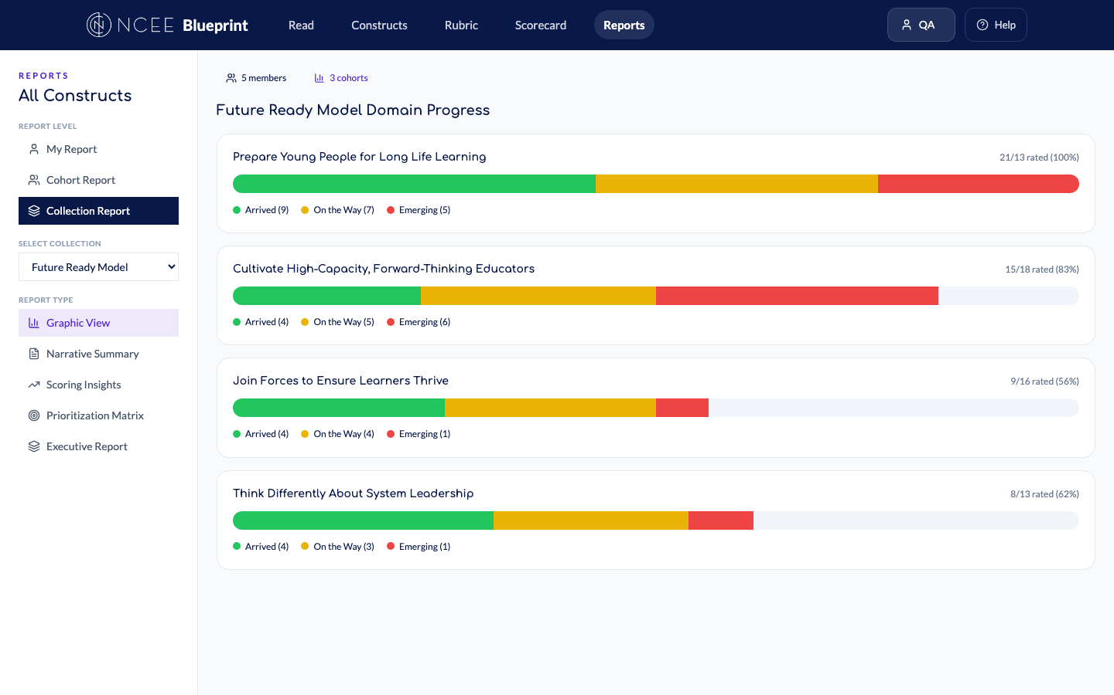
Aggregated Reports: Cohort & Collection
NEW
Cohort Report: facilitators pick a cohort and see where the group stands. This replaces manual theme extraction across individual reports.
Collection Report: admins see aggregated data across all cohorts using the same offering. For R&E evaluation and cross-district analysis.
NCEE Interactive Blueprint | Black Flag Design | SOW 1449 | Apr 9, 2026

Slide 9
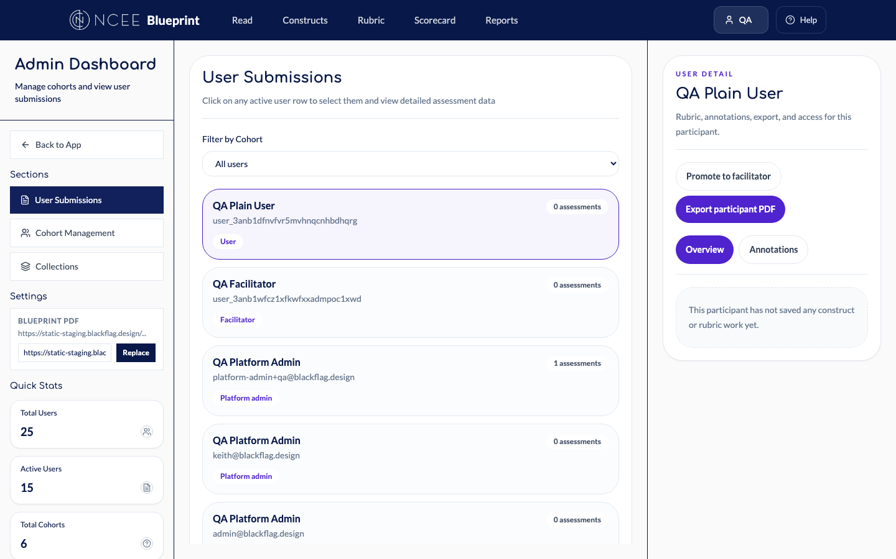
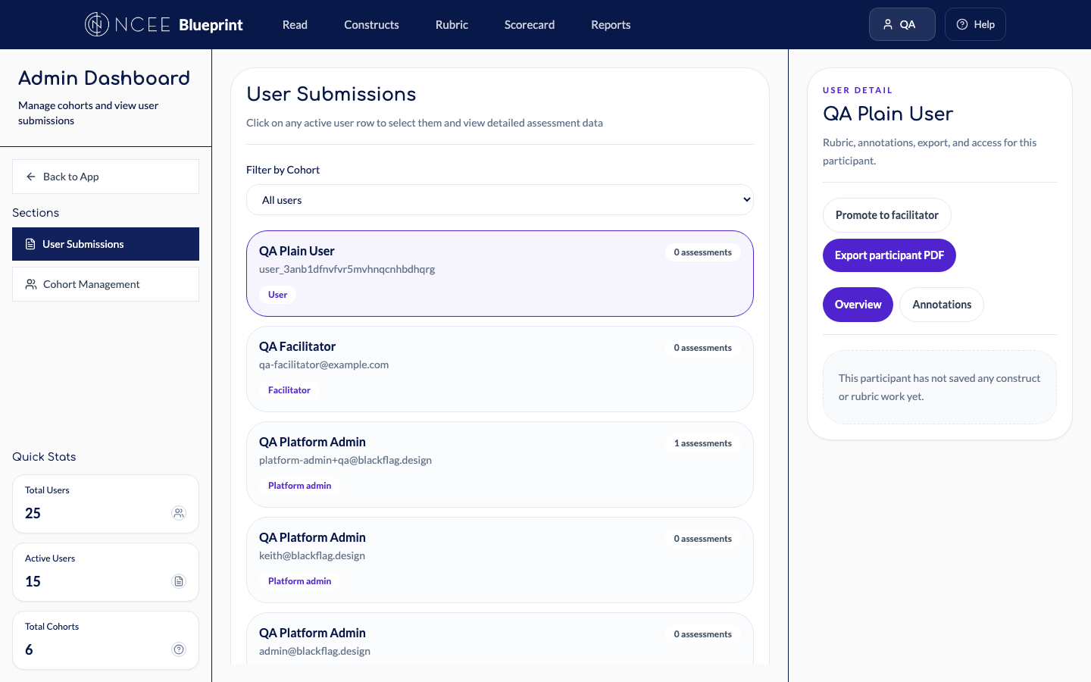

Role-Based Access Control
System Admin sees all 3 tabs + Settings. Full control over collections, cohorts, and platform config.
Facilitator sees only Submissions + Cohorts. No access to Collections or Settings — exactly as Carol requested.
Participant sees only their own report. No cohort or collection options. Clean, focused experience.
NCEE Interactive Blueprint | Black Flag Design | SOW 1449 | Apr 9, 2026

Slide 10
Salesforce Integration & User Identity
SALESFORCE TYPE
BLUEPRINT ROLE
EXPERIENCE
NCEE Staff
Facilitator
All cohorts, all data, admin access
National/Local Facilitator
Facilitator
Assigned cohorts + member data
Participant
Participant
Collection-scoped experience
No SF Record (Public)
Participant
Full blueprint, own data only
Platform Admin
System Admin
Everything + collection mgmt
Fixed this sprint: Clerk-to-Salesforce identity linking is now automatic. Users are recognized and assigned the correct role on first sign-in.
NCEE Interactive Blueprint | Black Flag Design | SOW 1449 | Apr 9, 2026

Slide 11
What’s Next
Salesforce SSO
OAuth login via Salesforce, deep links from OnwardLearn, "Return to OnwardLearn" button. In progress.
Learner Profile Collection
Awaiting Carol’s construct list (expected by April 11). Will be the fifth active collection.
Completion Heat Map
Visual indicator of which cohort members have completed assessments, so facilitators know when reports are meaningful.
Public Access V1
A distinct experience for users without a Salesforce account who access the Blueprint directly.
NCEE Interactive Blueprint | Black Flag Design | SOW 1449 | Apr 9, 2026

Slide 12
Discussion Items
1
Collection selector UX — Dropdown vs. segmented control for switching between collections?
2
Default for new cohorts — Must every cohort have a collection, or is "all 73 constructs" a valid default?
3
Report export — Reports are in-app only. Is PDF export needed for stakeholders outside the system?
4
Completion threshold — At what % of cohort completion should we flag that a report is ready? Currently 80%.
5
Cross-platform alignment — How does the Blueprint’s reporting connect to needs across other NCEE platforms?
NCEE Interactive Blueprint | Black Flag Design | SOW 1449 | Apr 9, 2026

Slide 13
Thank You
Interactive Blueprint • SOW 1449 • Service 2

